Slide 1
Intro to Neutral-atom Quantum Computing
MIT iQuHack
Pedro Lopes, PhD + Phillip Weinberg, PhD

Slide 2
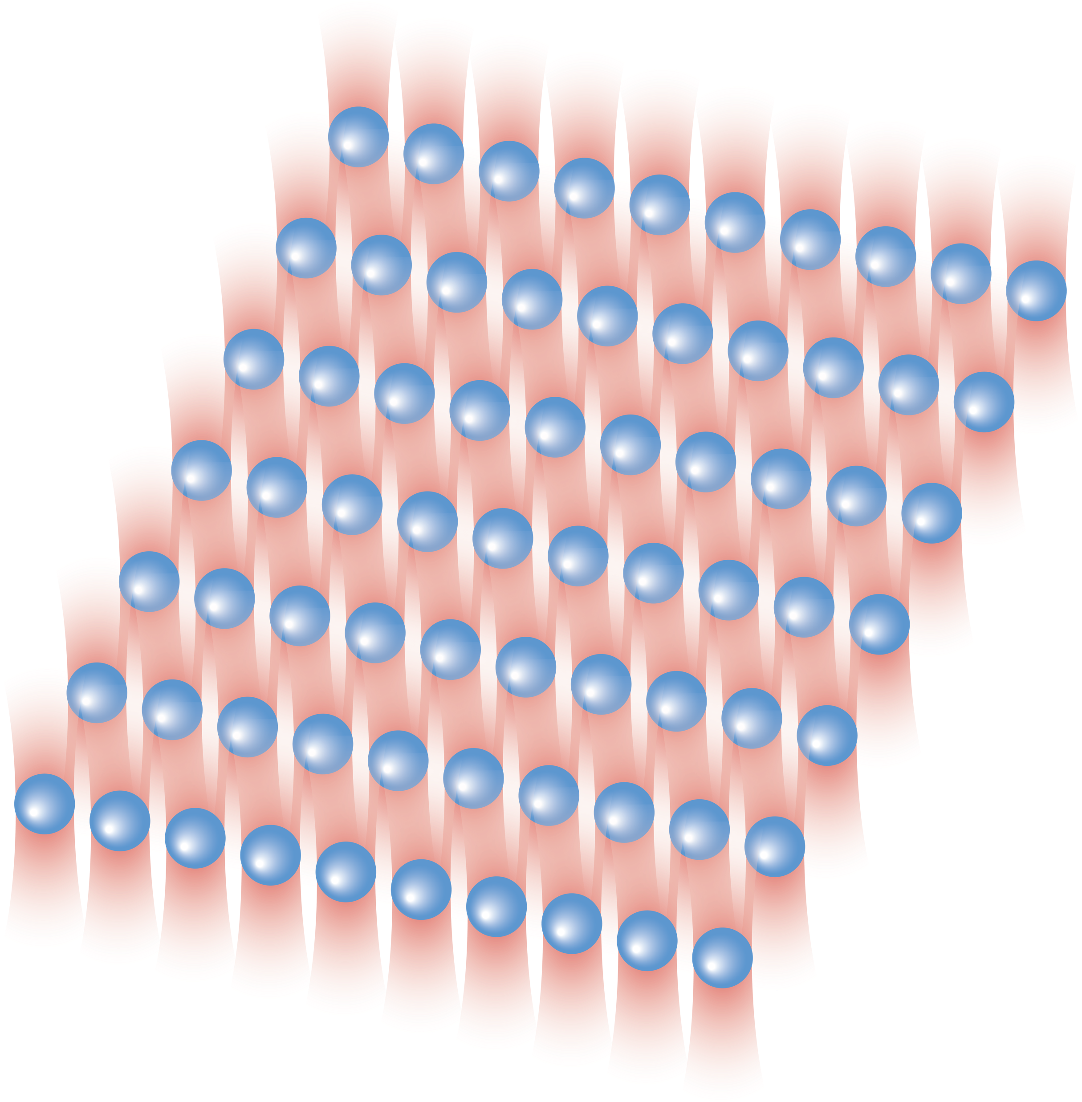
Why neutral-atom quantum processor
Densely packed qubits (atoms)
Efficient qubit control
Flexible problem encoding
The fastest path to quantum error correction
New ways to think quantum computing!

Slide 3

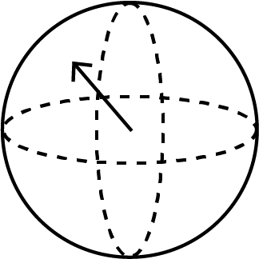

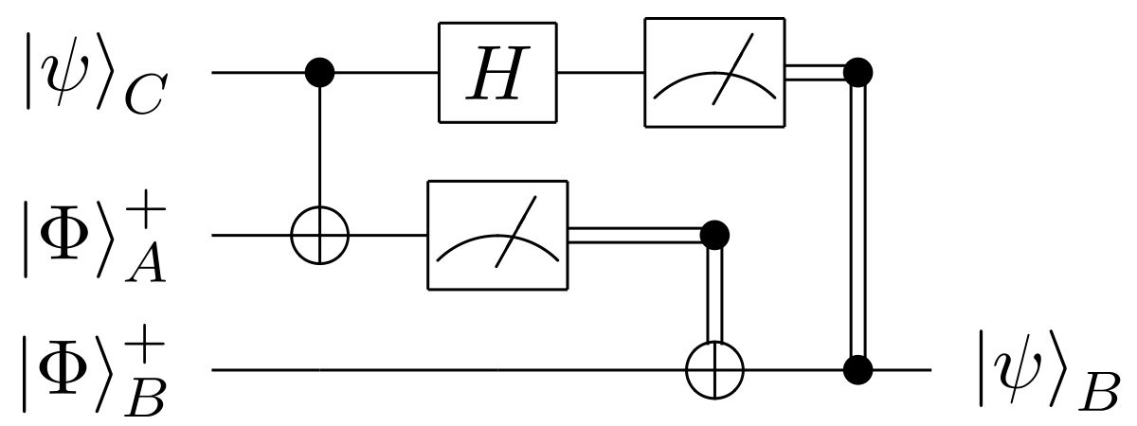
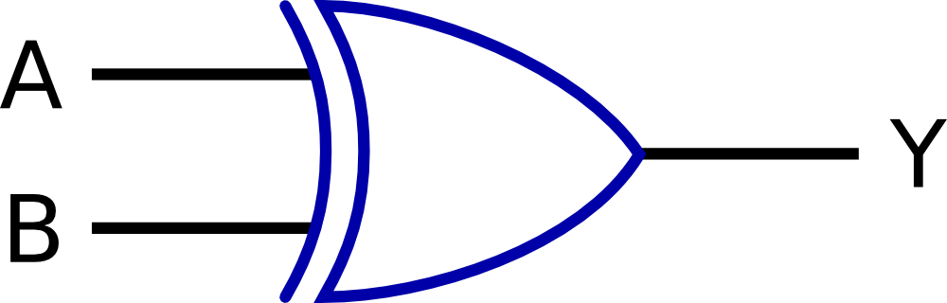

Quantum computing == new rules!
Classical
Quantum
Information input
bits
qubits
Information processing
Logic gates
Quantum gates
Results & output
Deterministic
Probabilistic & deterministic

Slide 4
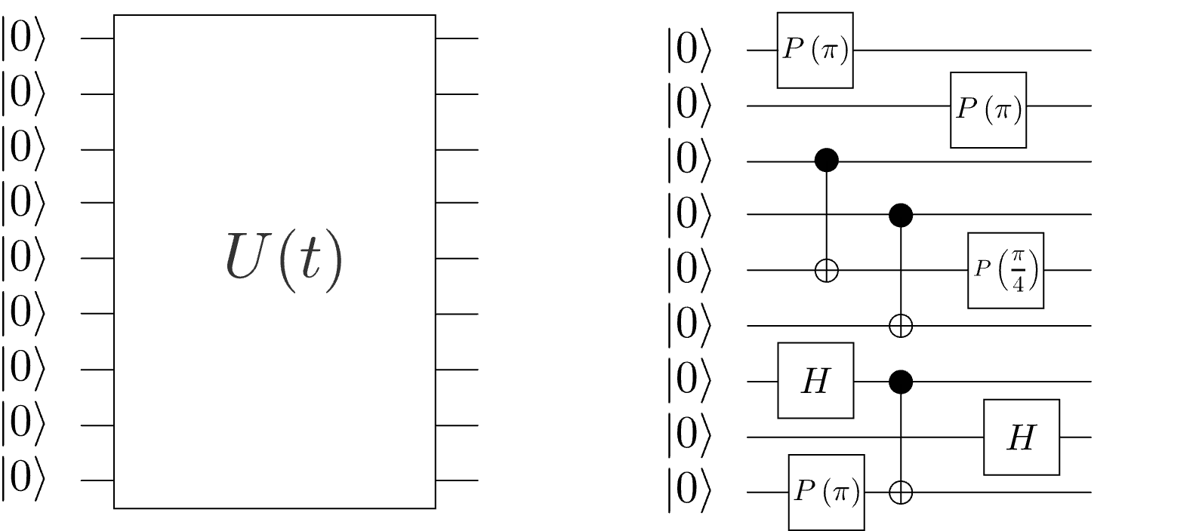


Paradigms of Q. Information processing
Analog operation
Digital operation
Designed for the early stage of maturity of the quantum computing resources of today…
Robustness to errors
Efficient control
Single-step large entanglement
Universal applicability
More on analog processors:
Nature volume 607, p. 667–676 (2022)

Slide 5
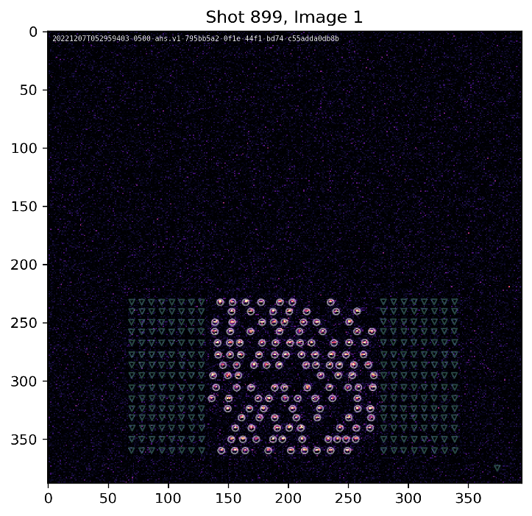
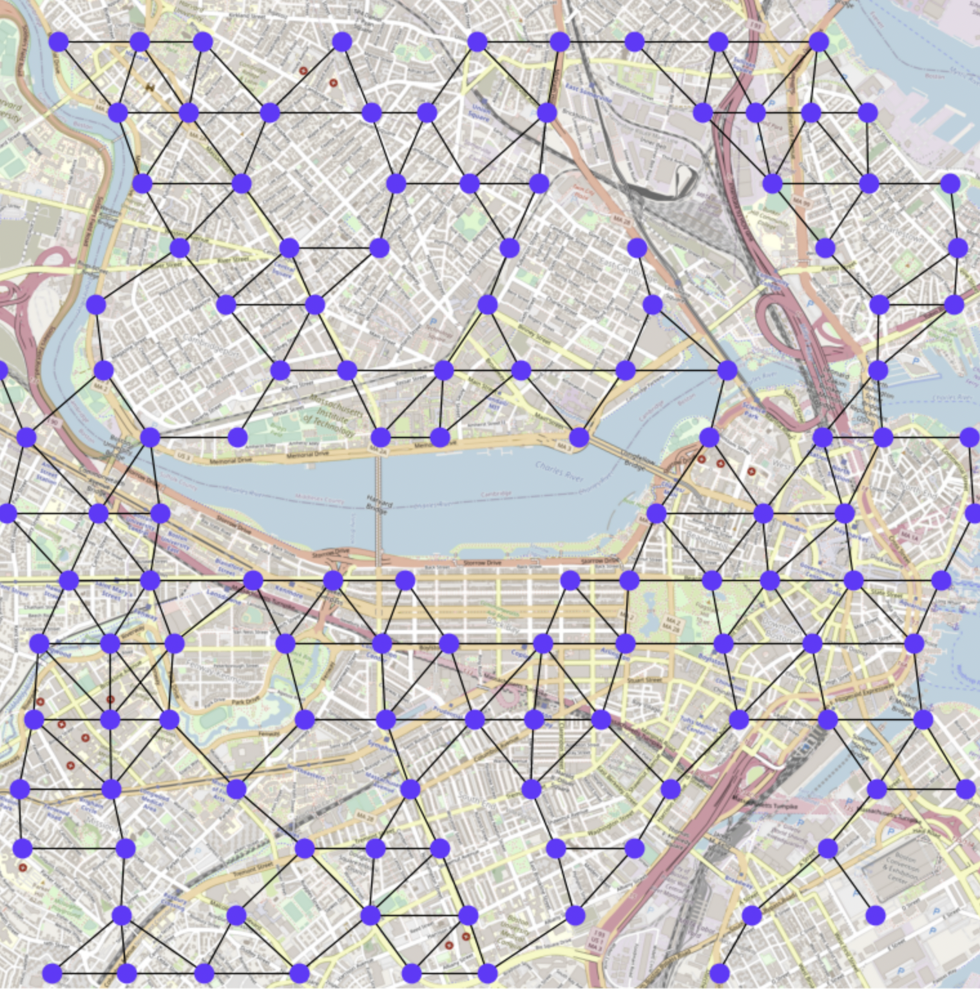
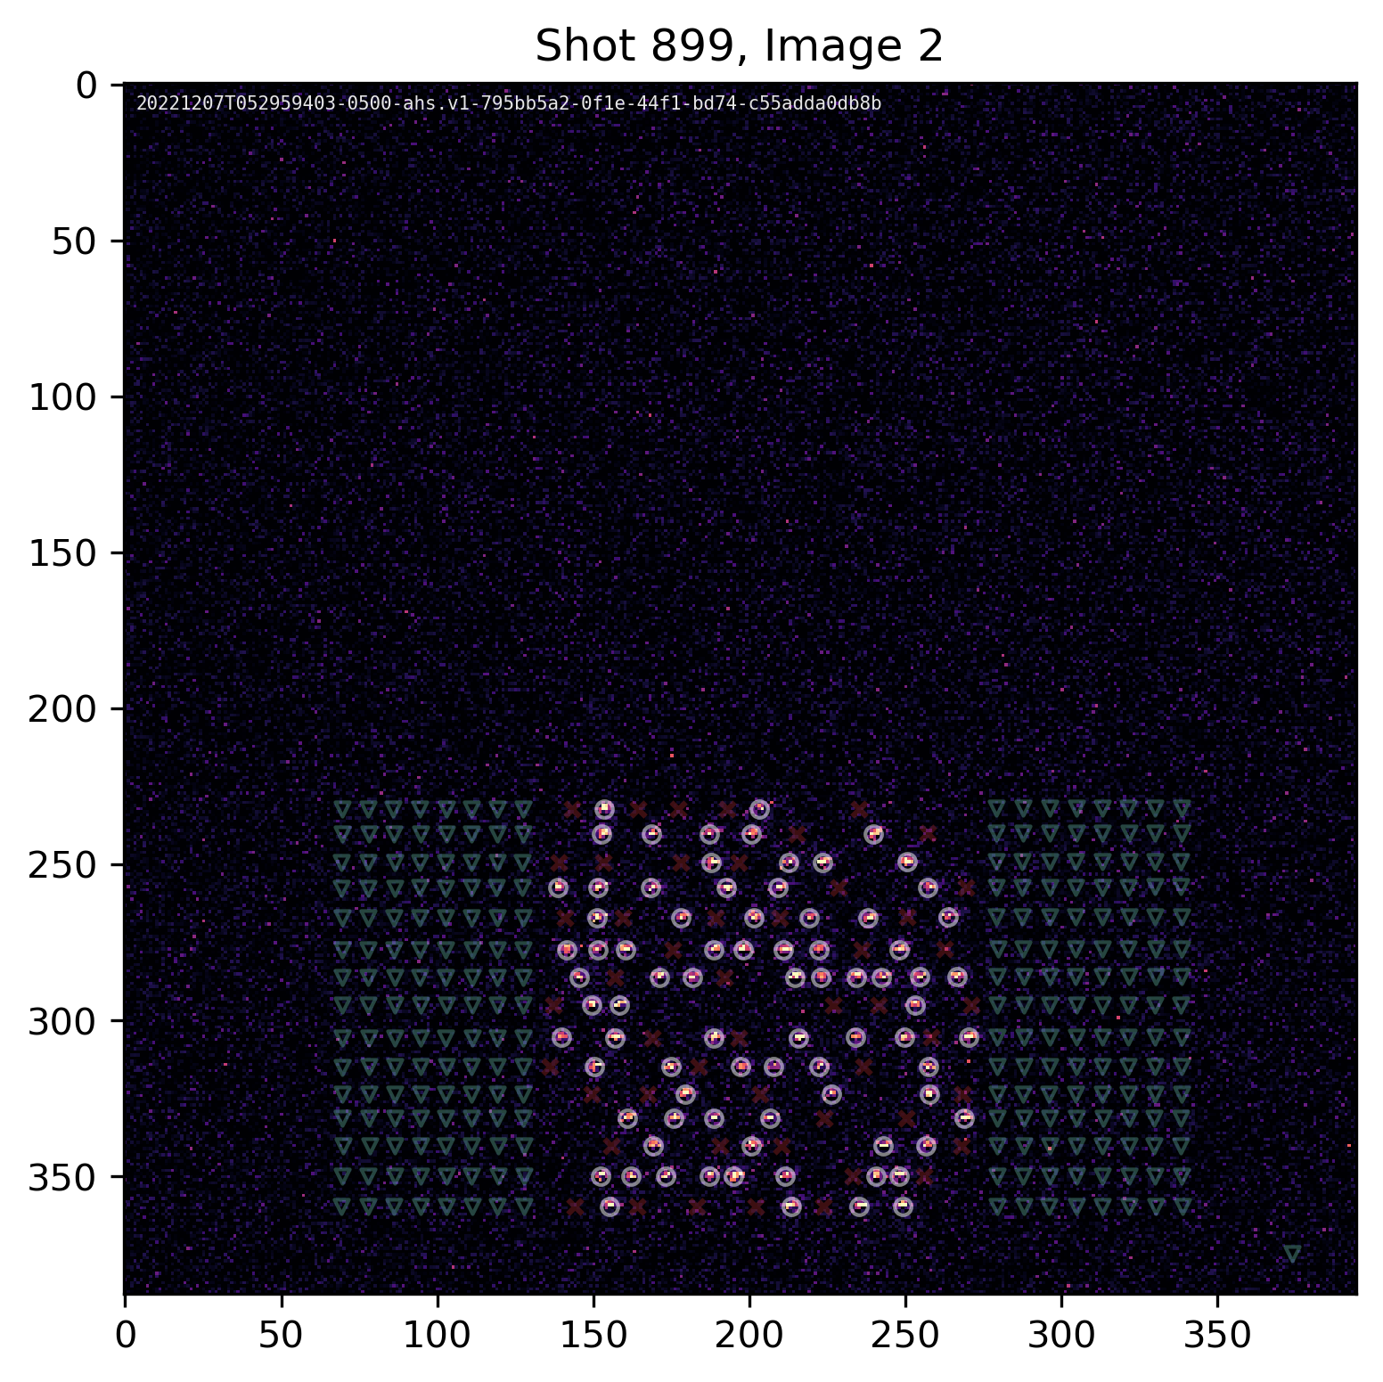
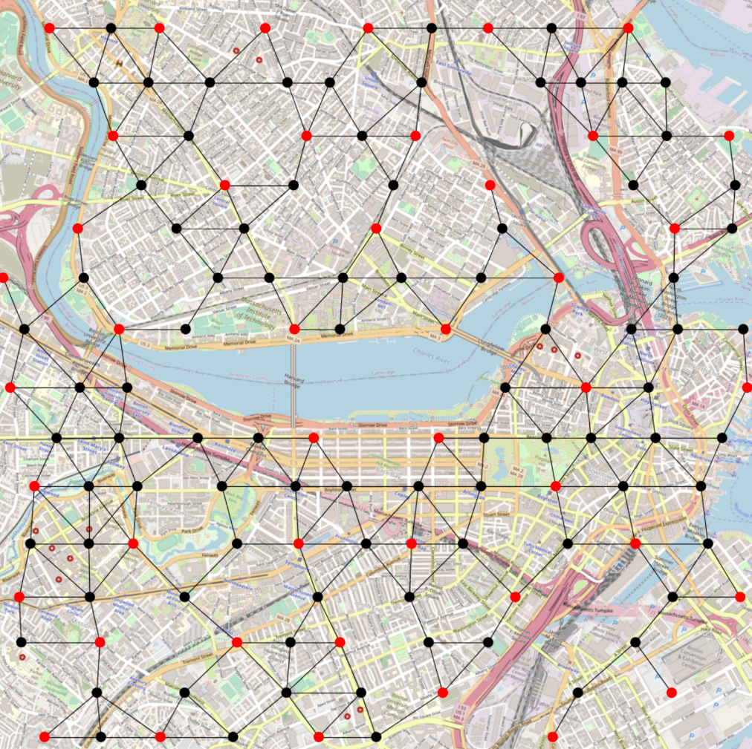
FPQA = Efficient Problem Encoding
Problem: choosing optimal locations in Boston
Possible locations as atom coordinates
Solution

Slide 6
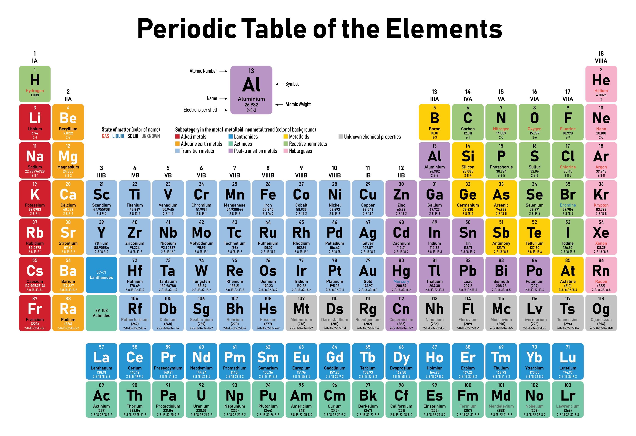
Architecture: qubits by puffing-up atoms

Slide 7
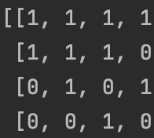
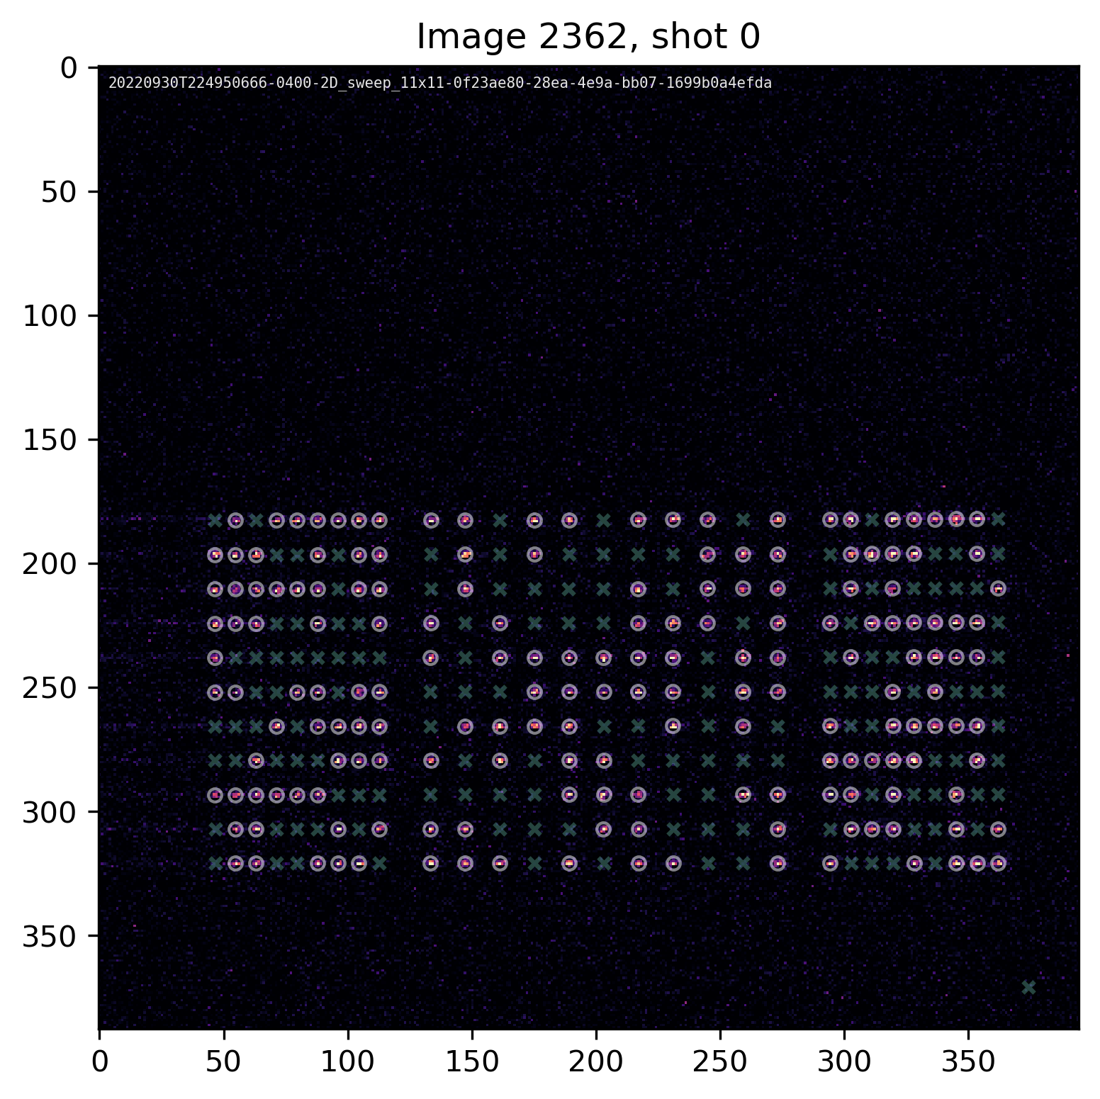
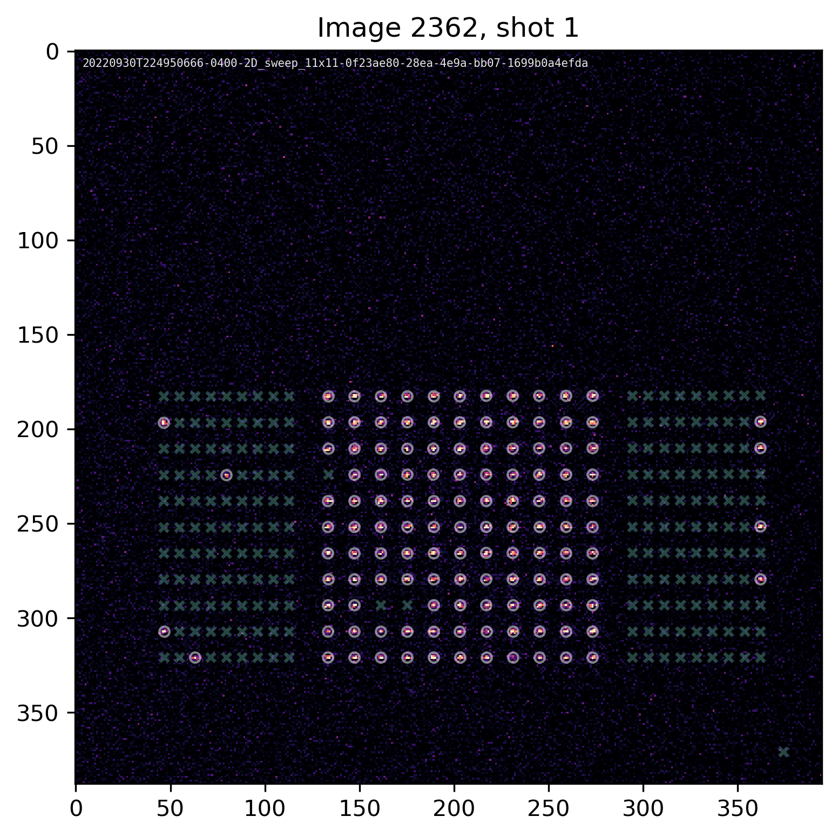
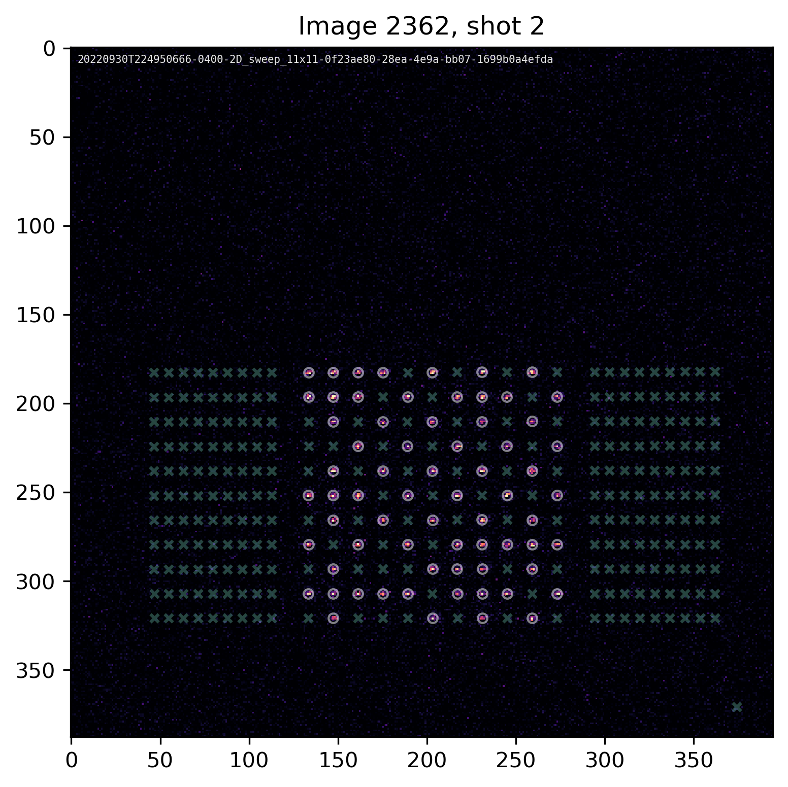
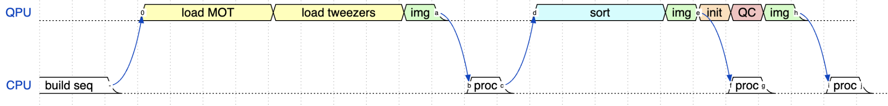
QPU cycle
State detection
> 95%
15ms
20ms
5ms
15ms
40ms
5ms
20us
15ms
40ms
5ms
5ms
Notes:
We build the processor at each shot.
Large dynamic range of time: 100s of ms duration for QPU cycle and calibrations, to 10s of ms duration prep step, to 0.1-20us Hamiltonian control analog waveforms with 10ns timing precision.
Crossover from ms to ns.

Slide 8
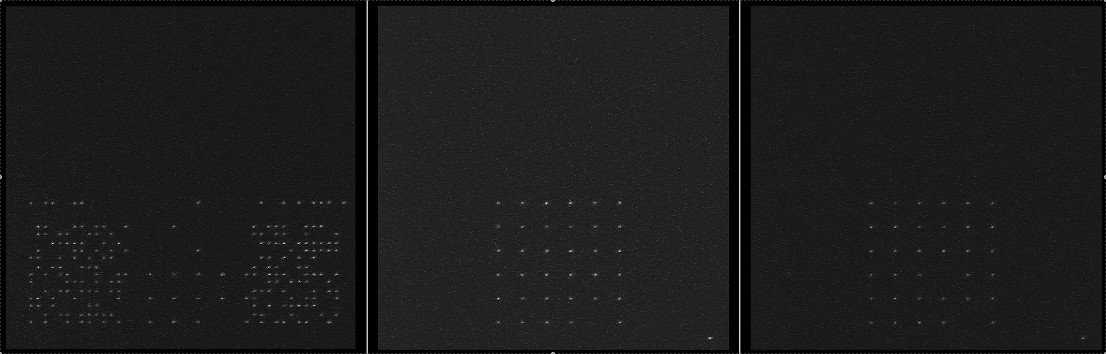
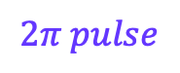
What qubit control really looks like:
$$2π pulse$$

Slide 9
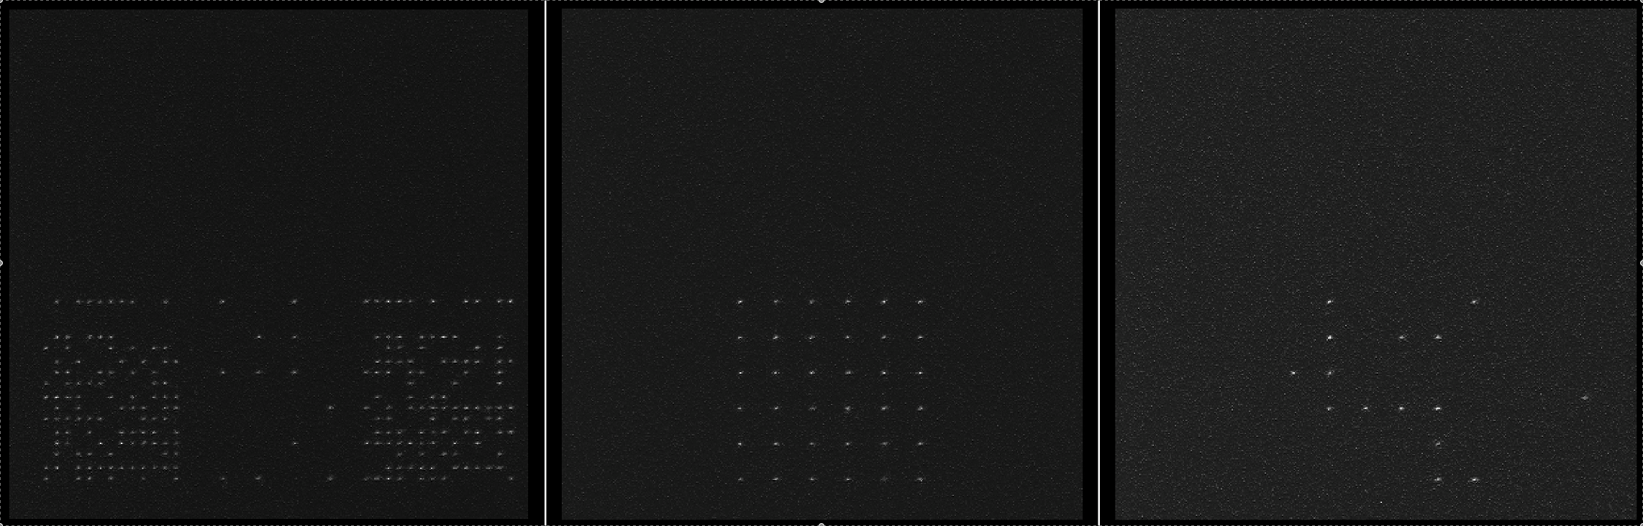
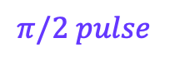
What qubit control really looks like:
$$π/2 pulse$$

Slide 10
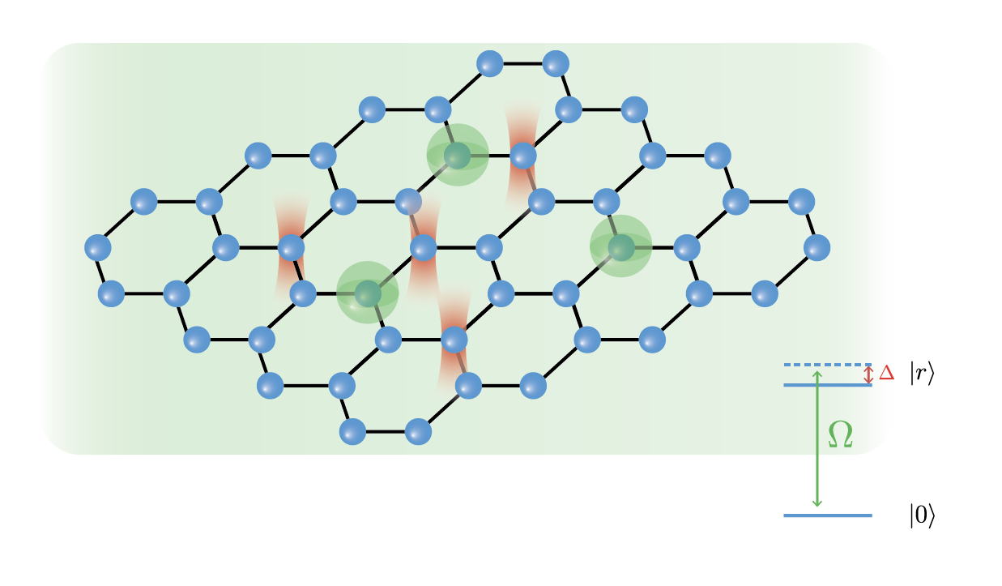
A neutral-atom quantum processor
Dynamics
(algorithms)
Geometry

Slide 11
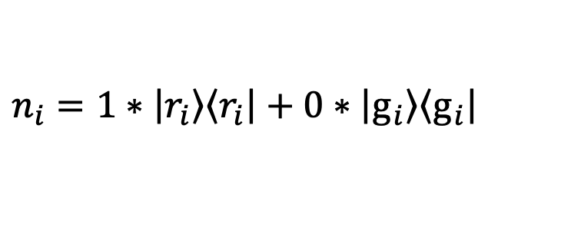
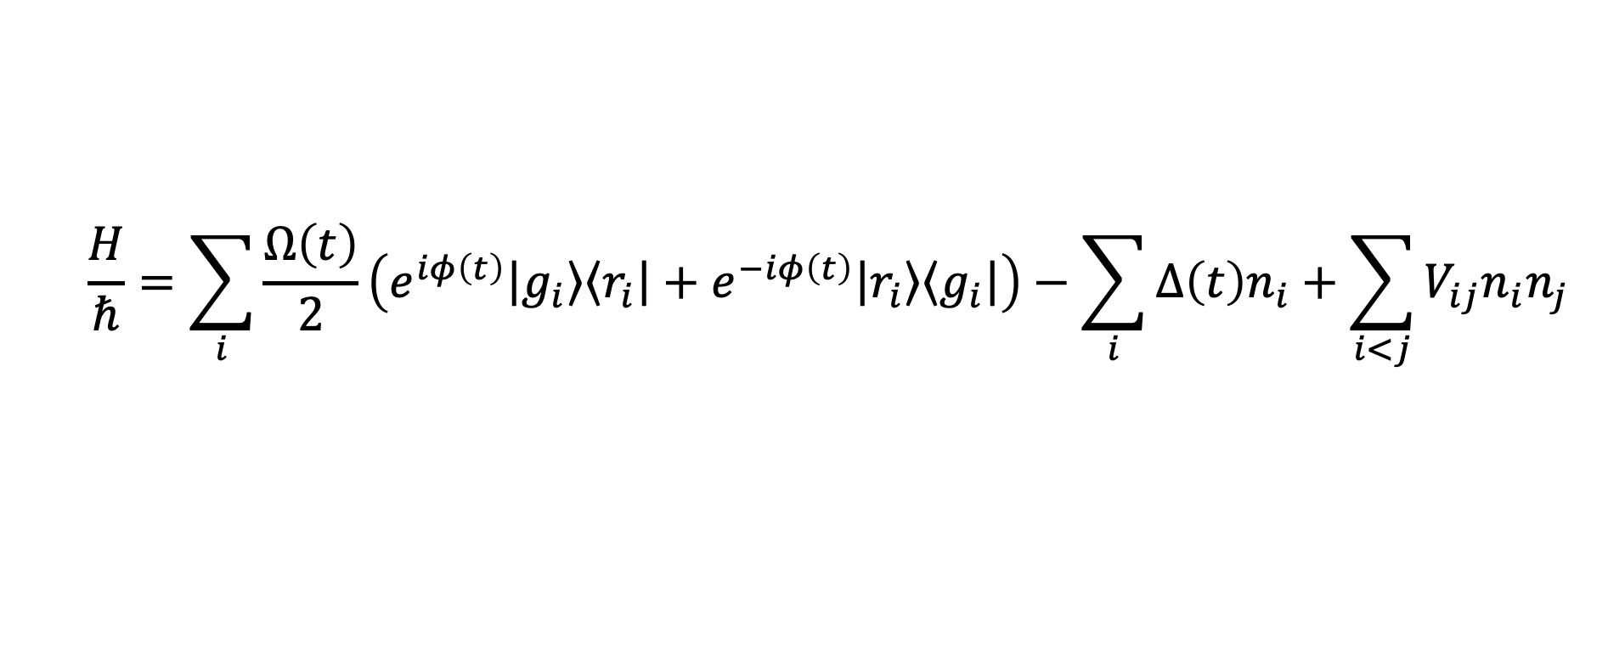
Analog quantum dynamics control
$$\frac{H}{ℏ}=\sum_{i}{\frac{Ω\left(t\right)}{2}\left(e^{iφ\left(t\right)}\left|\left.g_{i}\right\rangle \right.\left\langle \left.r_{i}\right|\right.+e^{−iφ\left(t\right)}\left|\left.r_{i}\right\rangle \right.\left\langle \left.g_{i}\right|\right.\right)−\sum_{i}{Δ\left(t\right)n_{i}}+\sum_{i<j}{V_{ij}n_{i}n_{j}}}$$
$$n_{i}=1∗\left|\left.r_{i}\right\rangle \right.\left\langle \left.r_{i}\right|\right.+0∗\left|\left.g_{i}\right\rangle \right.\left\langle \left.g_{i}\right|\right.$$

Slide 12
Hardware constraints: Geometry
1
2
3
Always in rows
4
5
6
8
9
7
More details @
https://queracomputing.github.io/Bloqade.jl/dev/capabilities/

Slide 13
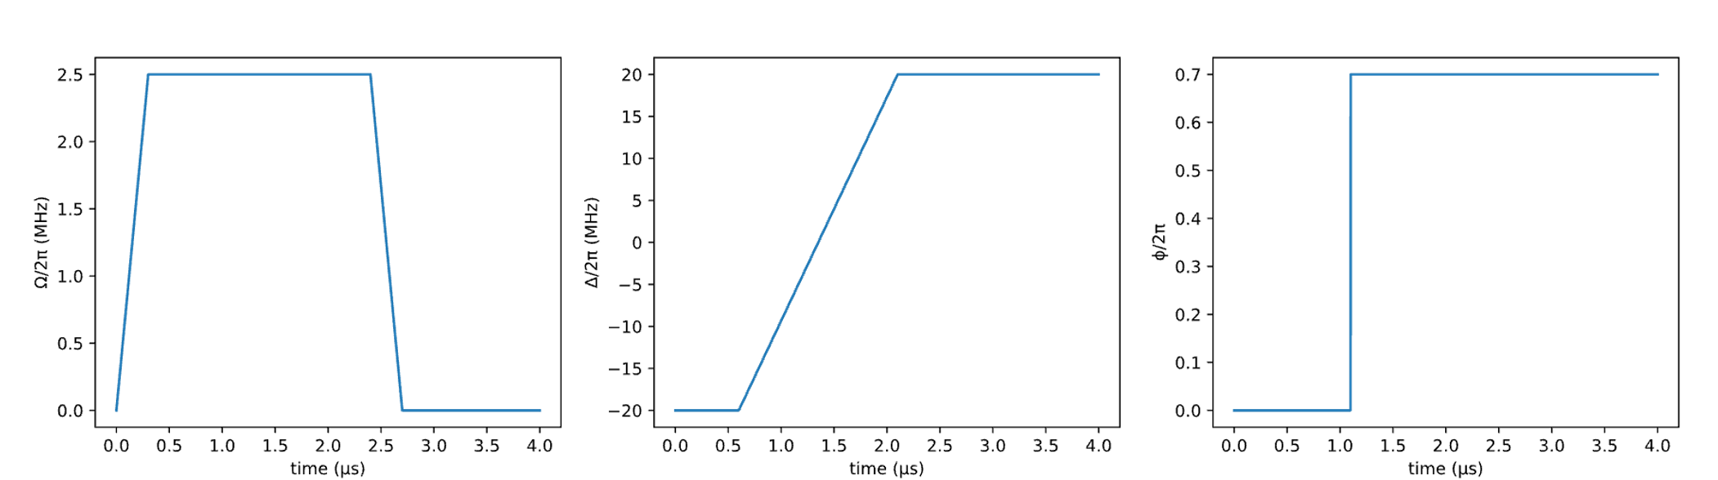
Hardware constraints: dynamics
Activity: Encoding waveforms on Bloqade
Piecewise-linear
Piecewise-constant

Slide 14

Rydberg blockade: phenomenology

Slide 15
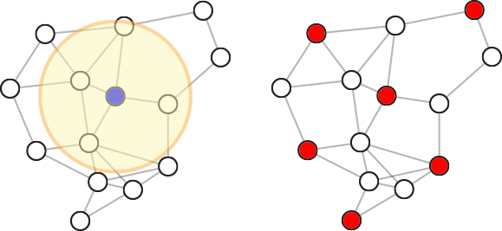
Rydberg blockade: utility
Maximum
Independent
Set
(NP-Complete)
Adapted from Ebadi et. al Science, 376, 6598 (2022)
15

Slide 16
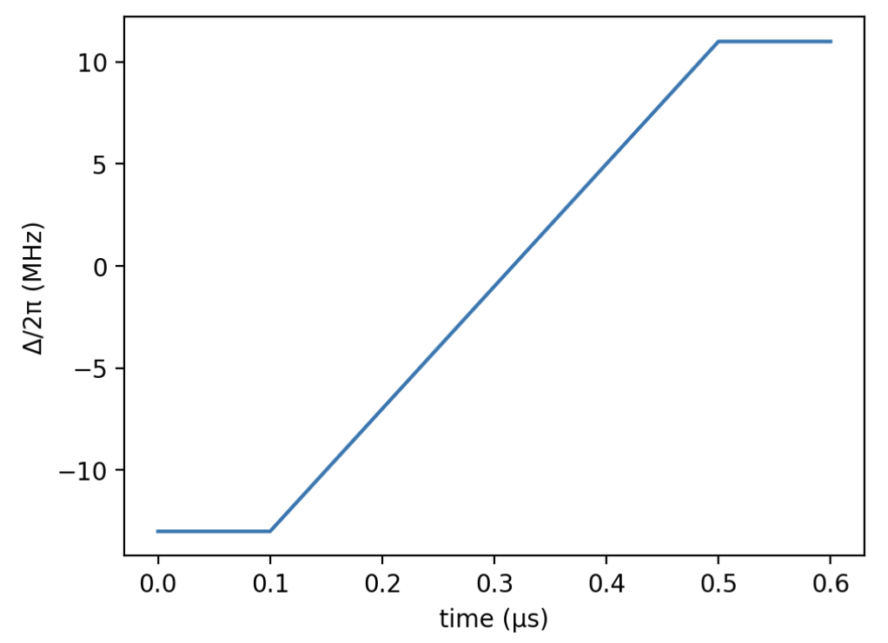
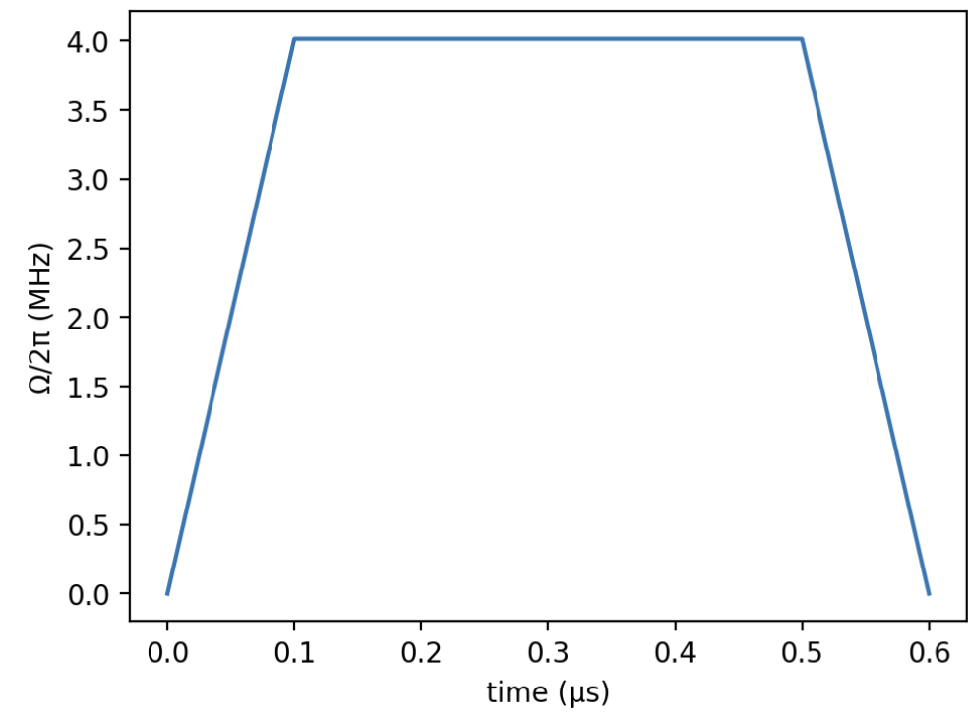
An algorithm for MIS

Slide 17
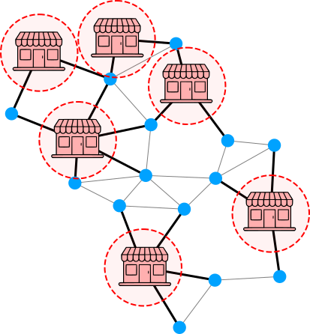
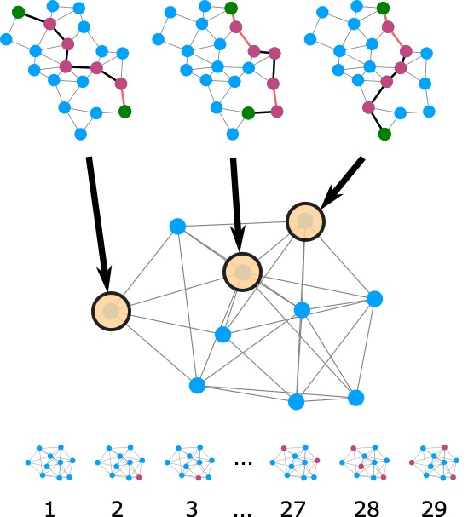
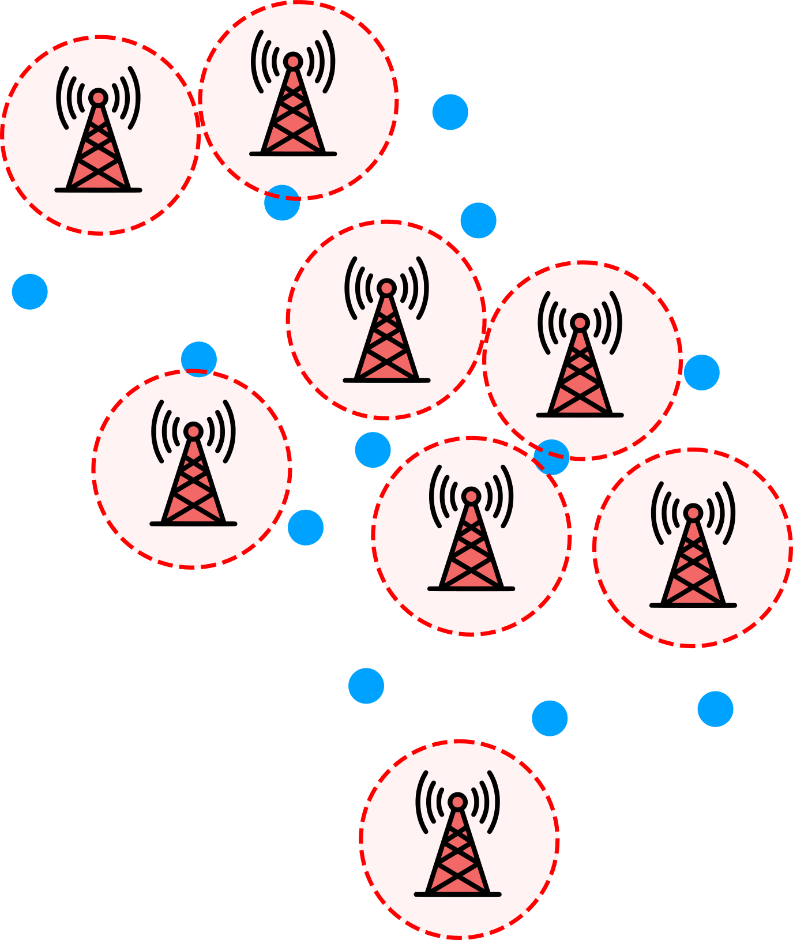
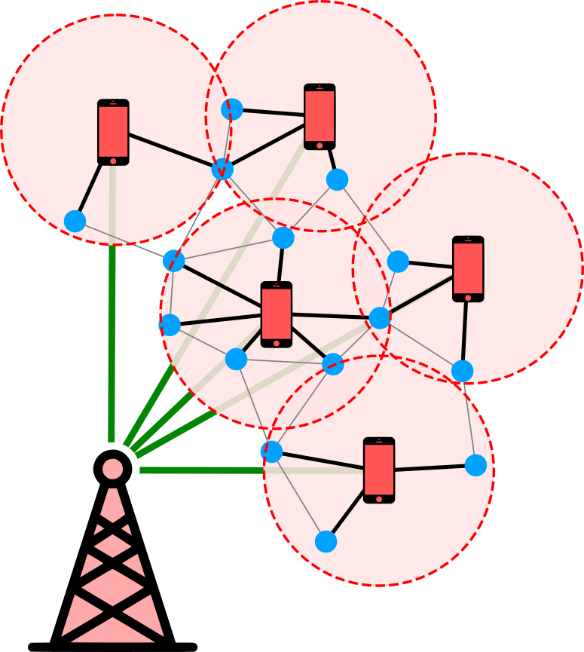
MIS applications are ubiquitous
Wurtz et al., “Industry applications of neutral-aom quantum computing solving independent set problems” https://arxiv.org/abs/2205.08500

Slide 18
Programming neutral atoms in 5 steps
Define atom positions => Rydberg radius
Define time traces of Hamiltonian parameters
Initialize Hamiltonian
Evolve!
Measure!

